Slide 1
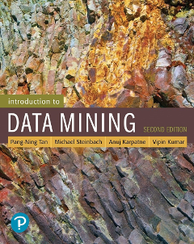
Chapter Seven: Cluster Analysis: Basic Concepts and Algorithms
CSCE 5380/4380 – Data Mining

Slide 2
Outline
Clustering Analysis
Types of Clusterings
Types of Clusters
Clustering Algorithms
Partitioning Clustering (K-means & variants)
Hierarchical Clustering (Agglomerative)
Density Based Clustering (DBSCAN)
Cluster Evaluation
Introduction to Data Mining, 2nd Edition

Slide 3
What is Cluster Analysis?
Given a set of objects, place them in groups such that the objects in a group are similar (or related) to one another and different from (or unrelated to) the objects in other groups
Inter-cluster distances are maximized
Intra-cluster distances are minimized

Slide 4
Types of Clusterings
A clustering is a set of clusters
Important distinction between hierarchical and partitional sets of clusters
Partitional Clustering
A division of data objects into non-overlapping subsets (clusters)
Hierarchical clustering
A set of nested clusters organized as a hierarchical tree

Slide 5
Partitional Clustering
Original Points
A Partitional Clustering

Slide 6
Hierarchical Clustering
Traditional Hierarchical Clustering
Traditional Dendrogram
Non-traditional Hierarchical Clustering
Non-traditional Dendrogram

Slide 7
Types of Clusters
Well-separated clusters
Prototype-based clusters
Contiguity-based clusters
Density-based clusters
Described by an Objective Function

Slide 8
Types of Clusters: Well-Separated
Well-Separated Clusters:
A cluster is a set of points such that any point in a cluster is closer (or more similar) to every other point in the cluster than to any point not in the cluster.
3 well-separated clusters

Slide 9
Types of Clusters: Prototype-Based
Prototype-based
A cluster is a set of objects such that an object in a cluster is closer (more similar) to the prototype or “center” of a cluster, than to the center of any other cluster
The center of a cluster is often a centroid, the average of all the points in the cluster, or a medoid, the most “representative” point of a cluster
4 center-based clusters

Slide 10
Types of Clusters: Contiguity-Based
Contiguous Cluster (Nearest neighbor or Transitive)
A cluster is a set of points such that a point in a cluster is closer (or more similar) to one or more other points in the cluster than to any point not in the cluster.
8 contiguous clusters

Slide 11
Types of Clusters: Density-Based
Density-based
A cluster is a dense region of points, which is separated by low-density regions, from other regions of high density.
Used when the clusters are irregular or intertwined, and when noise and outliers are present.
6 density-based clusters

Slide 12
Types of Clusters: Objective Function
Clusters Defined by an Objective Function
Finds clusters that minimize or maximize an objective function.
Enumerate all possible ways of dividing the points into clusters and evaluate the `goodness' of each potential set of clusters by using the given objective function. (NP Hard)
Can have global or local objectives.
Hierarchical clustering algorithms typically have local objectives
Partitional algorithms typically have global objectives
A variation of the global objective function approach is to fit the data to a parameterized model.
Parameters for the model are determined from the data.
Mixture models assume that the data is a ‘mixture' of a number of statistical distributions.

Slide 13
Characteristics of the Input Data Are Important
Type of proximity or density measure
Central to clustering
Depends on data and application
Data characteristics that affect proximity and/or density are
Dimensionality
Sparseness
Attribute type
Special relationships in the data
For example, autocorrelation
Distribution of the data
Noise and Outliers
Often interfere with the operation of the clustering algorithm
Clusters of differing sizes, densities, and shapes

Slide 14
Clustering Algorithms
K-means and its variants
(Covering of the algorithm)
Hierarchical clustering
(covering of the algorithm)
Density-based clustering
(Introducing the algorithm)

Slide 15
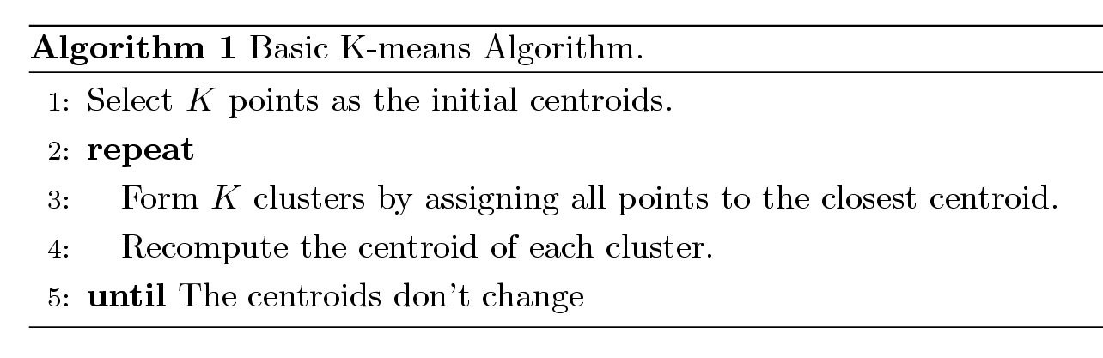
K-means Clustering
Partitional clustering approach
Number of clusters, K, must be specified
Each cluster is associated with a centroid (center point)
Each point is assigned to the cluster with the closest centroid
The basic algorithm is very simple

Slide 16
Example of K-means Clustering

Slide 17
K-means Clustering – Details
Simple iterative algorithm.
Choose initial centroids;
repeat {assign each point to a nearest centroid; re-compute cluster centroids}
until centroids stop changing.
Initial centroids are often chosen randomly.
Clusters produced can vary from one run to another
The centroid is (typically) the mean of the points in the cluster, but other definitions are possible (see Table 7.2).
K-means will converge for common proximity measures with appropriately defined centroid (see Table 7.2)
Most of the convergence happens in the first few iterations.
Often the stopping condition is changed to ‘Until relatively few points change clusters’
Complexity is O( n * K * I * d )
n = number of points, K = number of clusters, I = number of iterations, d = number of attributes

Slide 18
K-means Objective Function
A common objective function (used with Euclidean distance measure) is Sum of Squared Error (SSE)
For each point, the error is the distance to the nearest cluster center
To get SSE, we square these errors and sum them.
x is a data point in cluster C_{i} and m_{i} is the centroid (mean) for cluster C_{i}
SSE improves in each iteration of K-means until it reaches a local or global minima.

Slide 19
Two different K-means Clusterings
Original Points
Optimal Clustering
Sub-optimal Clustering

Slide 20
Importance of Choosing Initial Centroids …

Slide 21
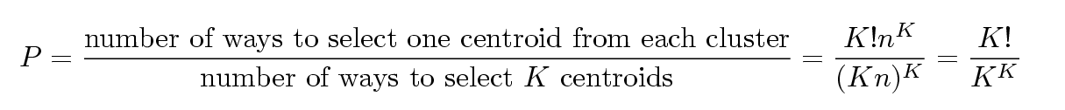
Problems with Selecting Initial Points
If there are K ‘real’ clusters then the chance of selecting one centroid from each cluster is small.
Chance is relatively small when K is large
If clusters are the same size, n, then
For example, if K = 10, then probability = 10!/10¹⁰ = 0.00036
Sometimes the initial centroids will readjust themselves in ‘right’ way, and sometimes they don’t

Slide 22
Solutions to Initial Centroids Problem
Multiple runs
Helps, but probability is not on your side
Use some strategy to select the k initial centroids and then select among these initial centroids
Select most widely separated
K-means++ is a robust way of doing this selection
Use hierarchical clustering to determine initial centroids
Bisecting K-means
Not as susceptible to initialization issues

Slide 23
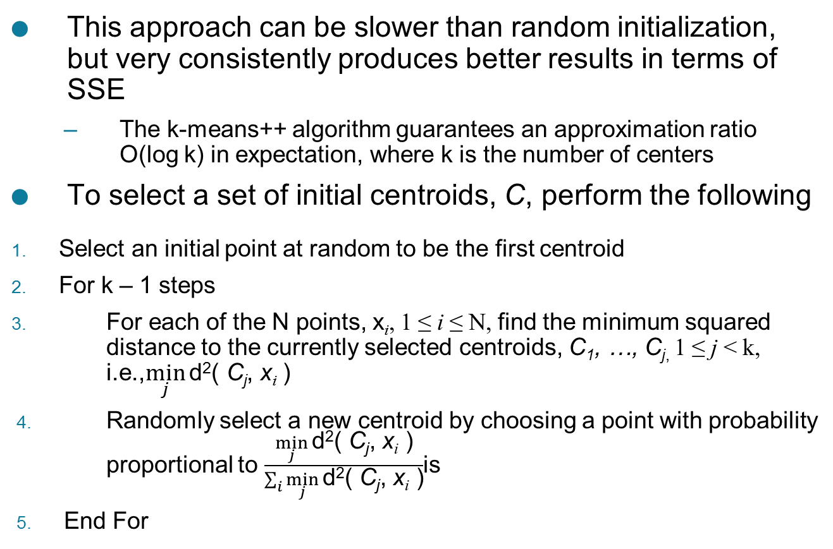
K-means++
This approach can be slower than random initialization, but very consistently produces better results in terms of SSE
The k-means++ algorithm guarantees an approximation ratio O(log k) in expectation, where k is the number of centers
To select a set of initial centroids, C, perform the following
Select an initial point at random to be the first centroid
For k – 1 steps
For each of the N points, x_{i}, 1 ≤ i ≤ N, find the minimum squared distance to the currently selected centroids, C₁, …, C_{j,} 1 ≤ j < k, i.e.,$\min_{j}{\text{d}\text{2}\text{( }\text{C}\text{j}\text{, }\text{x}\text{i}\text{ )}}$
Randomly select a new centroid by choosing a point with probability proportional to $\frac{\min_{j}{\text{d}\text{2}\text{( }\text{C}\text{j}\text{, }\text{x}\text{i}\text{ )}}}{\sum_{i}{\min_{j}{\text{d}\text{2}\text{( }\text{C}\text{j}\text{, }\text{x}\text{i}\text{ )}}}}$is
End For

Slide 24
Bisecting K-means
Bisecting K-means algorithm
Variant of K-means that can produce a partitional or a hierarchical clustering
CLUTO: http://glaros.dtc.umn.edu/gkhome/cluto/cluto/overview

Slide 25
Limitations of K-means
K-means has problems when clusters are of differing
Sizes
Densities
Non-globular shapes
K-means has problems when the data contains outliers.
One possible solution is to remove outliers before clustering

Slide 26
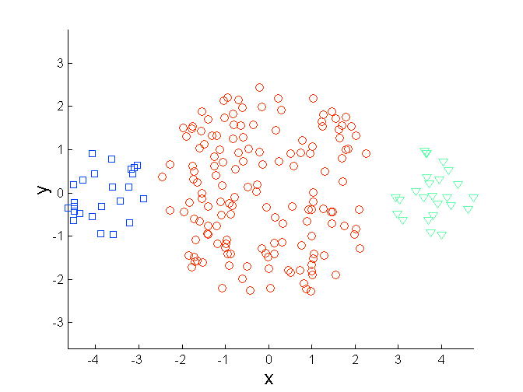
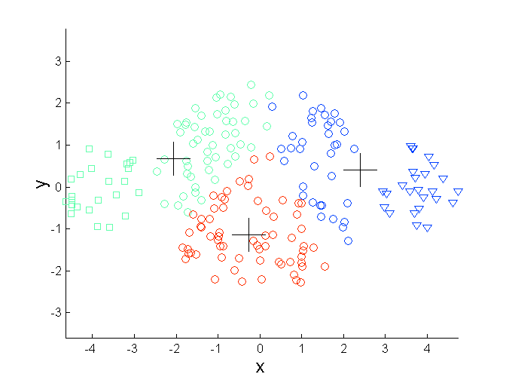
Limitations of K-means: Differing Sizes
Original Points
K-means (3 Clusters)

Slide 27
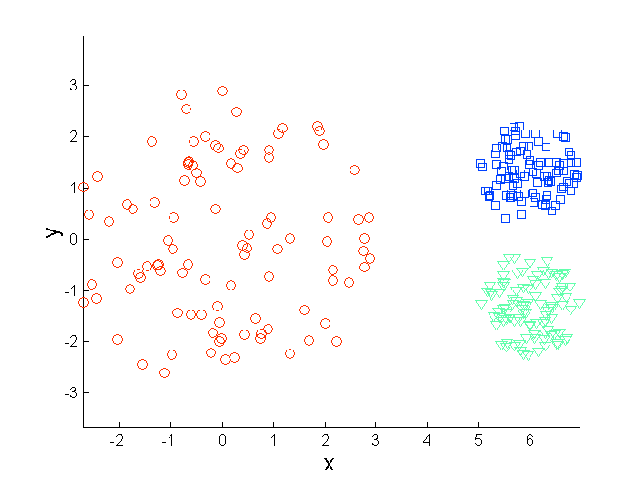
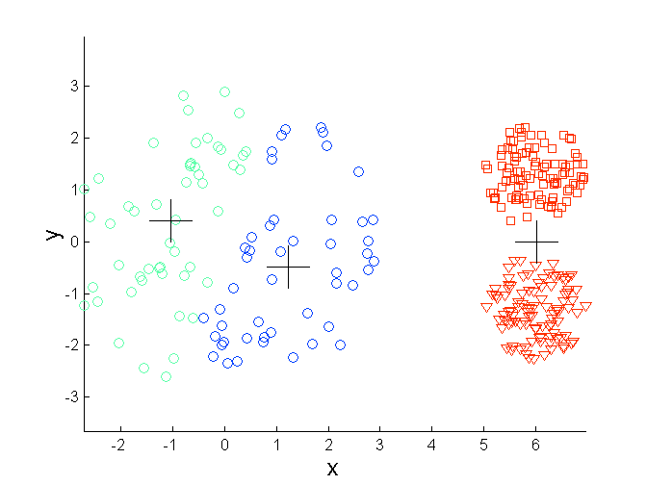
Limitations of K-means: Differing Density
Original Points
K-means (3 Clusters)

Slide 28
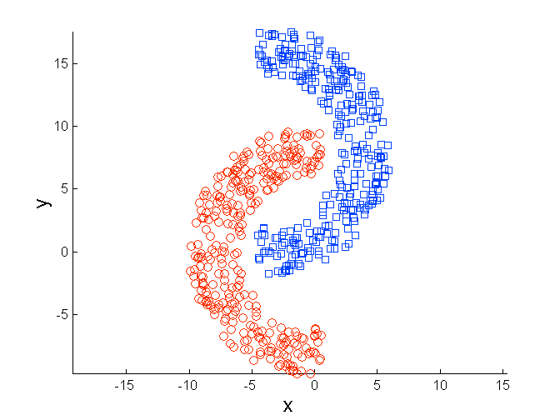
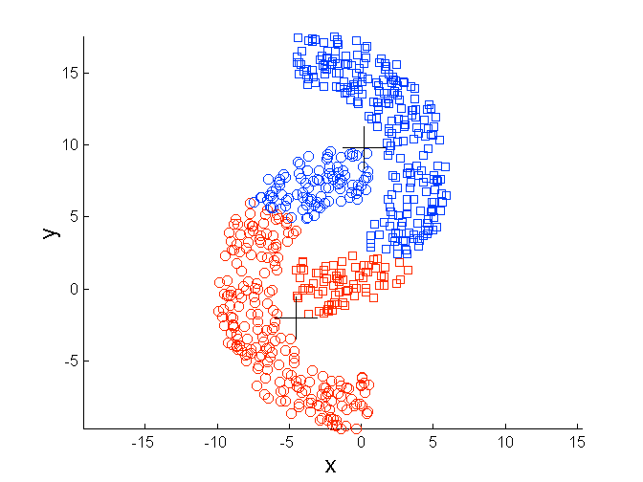
Limitations of K-means: Non-globular Shapes
Original Points
K-means (2 Clusters)

Slide 29
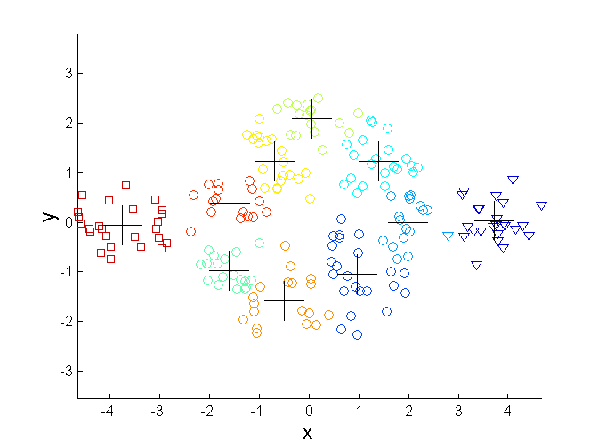
Overcoming K-means Limitations - Sizes
Original Points K-means Clusters
One solution is to find a large number of clusters such that each of them represents a part of a natural cluster. But these small clusters need to be put together in a post-processing step.

Slide 30
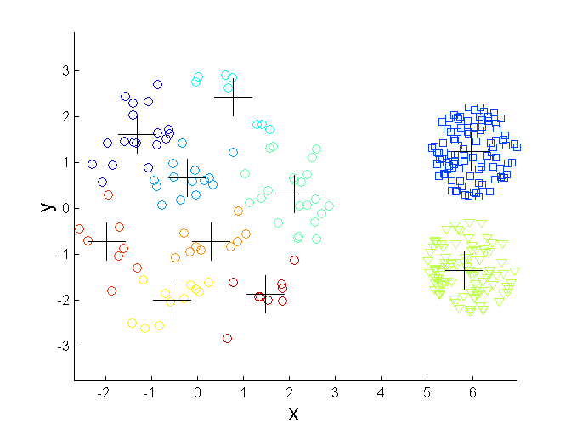
Overcoming K-means Limitations - Density
Original Points K-means Clusters
One solution is to find a large number of clusters such that each of them represents a part of a natural cluster. But these small clusters need to be put together in a post-processing step.

Slide 31
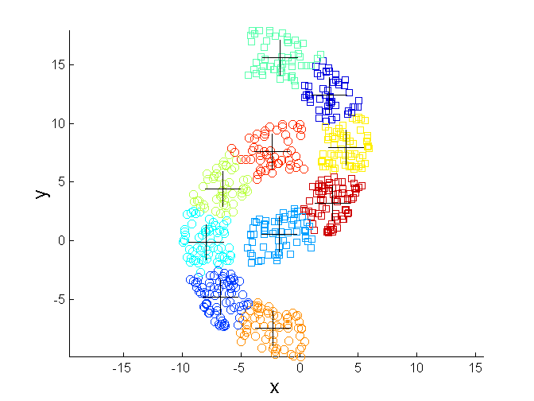
Overcoming K-means Limitations - Shapes
Original Points K-means Clusters
One solution is to find a large number of clusters such that each of them represents a part of a natural cluster. But these small clusters need to be put together in a post-processing step.

Slide 32
Hierarchical Clustering
Produces a set of nested clusters organized as a hierarchical tree
Can be visualized as a dendrogram
A tree like diagram that records the sequences of merges or splits

Slide 33
Strengths of Hierarchical Clustering
Do not have to assume any particular number of clusters
Any desired number of clusters can be obtained by ‘cutting’ the dendrogram at the proper level
They may correspond to meaningful taxonomies
Example in biological sciences (e.g., animal kingdom, phylogeny reconstruction, …)

Slide 34
Hierarchical Clustering
Two main types of hierarchical clustering
Agglomerative:
Start with the points as individual clusters
At each step, merge the closest pair of clusters until only one cluster (or k clusters) left
Divisive:
Start with one, all-inclusive cluster
At each step, split a cluster until each cluster contains an individual point (or there are k clusters)
Traditional hierarchical algorithms use a similarity or distance matrix
Merge or split one cluster at a time

Slide 35
Agglomerative Clustering Algorithm
Key Idea: Successively merge closest clusters
Basic algorithm
Compute the proximity matrix
Let each data point be a cluster
Repeat
Merge the two closest clusters
Update the proximity matrix
Until only a single cluster remains
Key operation is the computation of the proximity of two clusters
Different approaches to defining the distance between clusters distinguish the different algorithms

Slide 36
Steps 1 and 2
Start with clusters of individual points and a proximity matrix
p1
p2
p3
p4
p5
. . .
p1
p2
p3
p4
p5
.
.
.
Proximity Matrix

Slide 37
Intermediate Situation
After some merging steps, we have some clusters
C1
C2
C3
C4
C5
C1
C2
C3
C3
C4
C4
C5
Proximity Matrix
C1
C2
C5

Slide 38
Step 4
We want to merge the two closest clusters (C2 and C5) and update the proximity matrix.
C1
C2
C3
C4
C5
C1
C2
C3
C3
C4
C4
C5
Proximity Matrix
C1
C2
C5

Slide 39
Step 5
The question is “How do we update the proximity matrix?”
C2 U C5
C1
C3
C4
C1
?
C2 U C5
? ? ? ?
C3
C3
?
C4
C4
?
Proximity Matrix
C1
C2 U C5

Slide 40
How to Define Inter-Cluster Distance
p1
p2
p3
p4
p5
. . .
p1
Similarity?
p2
p3
p4
p5
MIN
MAX
Group Average
Distance Between Centroids
Other methods driven by an objective function
Ward’s Method uses squared error
.
.
.
Proximity Matrix

Slide 41
How to Define Inter-Cluster Similarity
p1
p2
p3
p4
p5
. . .
p1
p2
p3
p4
p5
MIN
MAX
Group Average
Distance Between Centroids
Other methods driven by an objective function
Ward’s Method uses squared error
.
.
.
Proximity Matrix

Slide 42
How to Define Inter-Cluster Similarity
p1
p2
p3
p4
p5
. . .
p1
p2
p3
p4
p5
MIN
MAX
Group Average
Distance Between Centroids
Other methods driven by an objective function
Ward’s Method uses squared error
.
.
.
Proximity Matrix

Slide 43
How to Define Inter-Cluster Similarity
p1
p2
p3
p4
p5
. . .
p1
p2
p3
p4
p5
MIN
MAX
Group Average
Distance Between Centroids
Other methods driven by an objective function
Ward’s Method uses squared error
.
.
.
Proximity Matrix

Slide 44
How to Define Inter-Cluster Similarity
p1
p2
p3
p4
p5
. . .
p1
×
×
p2
p3
p4
p5
MIN
MAX
Group Average
Distance Between Centroids
Other methods driven by an objective function
Ward’s Method uses squared error
.
.
.
Proximity Matrix

Slide 45
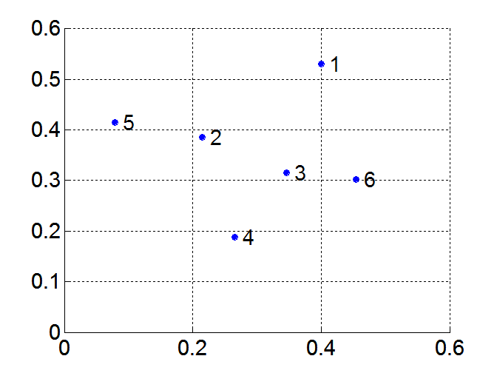
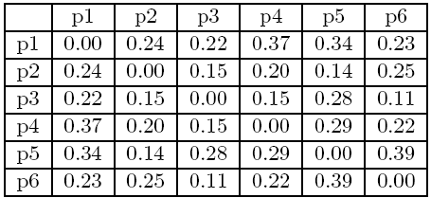
MIN or Single Link
Proximity of two clusters is based on the two closest points in the different clusters
Determined by one pair of points, i.e., by one link in the proximity graph
Example:
Distance Matrix:

Slide 46
Hierarchical Clustering: MIN
5
1
3
5
2
1
2
3
6
4
4
Nested Clusters
Dendrogram

Slide 47
Strength of MIN
Original Points
Six Clusters
Can handle non-elliptical shapes

Slide 48
Limitations of MIN
Two Clusters
Original Points
Sensitive to noise
Three Clusters

Slide 49


MAX or Complete Linkage
Proximity of two clusters is based on the two most distant points in the different clusters
Determined by all pairs of points in the two clusters
Distance Matrix:

Slide 50
Hierarchical Clustering: MAX
4
1
2
5
5
2
3
6
3
1
4
Nested Clusters
Dendrogram

Slide 51
Strength of MAX
Original Points
Two Clusters
Less susceptible to noise

Slide 52
Limitations of MAX
Original Points
Two Clusters
Tends to break large clusters
Biased towards globular clusters

Slide 53
Group Average
Proximity of two clusters is the average of pairwise proximity between points in the two clusters.
Distance Matrix:

Slide 54
Hierarchical Clustering: Group Average
5
4
1
2
5
2
3
6
1
4
3
Nested Clusters
Dendrogram

Slide 55
Hierarchical Clustering: Group Average
Compromise between Single and Complete Link
Strengths
Less susceptible to noise
Limitations
Biased towards globular clusters

Slide 56
Cluster Similarity: Ward’s Method
Similarity of two clusters is based on the increase in squared error when two clusters are merged
Similar to group average if distance between points is distance squared
Less susceptible to noise
Biased towards globular clusters
Hierarchical analogue of K-means
Can be used to initialize K-means

Slide 57
Hierarchical Clustering: Comparison
5
1
4
1
3
2
5
5
5
2
1
MIN
2
MAX
2
3
6
3
3
6
1
4
4
4
5
5
1
4
1
2
2
5
2
Ward’s Method
5
2
3
6
Group Average
3
3
6
4
1
1
4
4
3

Slide 58
Hierarchical Clustering: Problems and Limitations
Once a decision is made to combine two clusters, it cannot be undone
No global objective function is directly minimized
Different schemes have problems with one or more of the following:
Sensitivity to noise
Difficulty handling clusters of different sizes and non-globular shapes
Breaking large clusters

Slide 59
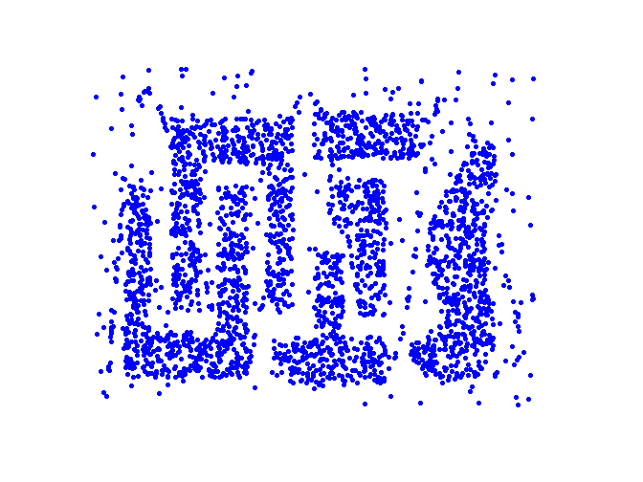
Density Based Clustering
Clusters are regions of high density that are separated from one another by regions on low density.

Slide 60
DBSCAN
DBSCAN is a density-based algorithm.
Density = number of points within a specified radius (Eps)
A point is a core point if it has at least a specified number of points (MinPts) within Eps
These are points that are at the interior of a cluster
Counts the point itself
A border point is not a core point, but is in the neighborhood of a core point
A noise point is any point that is not a core point or a border point

Slide 61
DBSCAN: Core, Border, and Noise Points
MinPts = 7

Slide 62
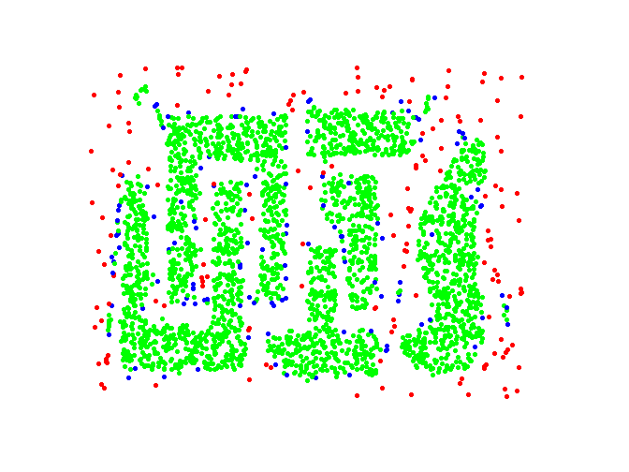
DBSCAN: Core, Border and Noise Points
Original Points
Point types: core, border and noise
Eps = 10, MinPts = 4

Slide 63
DBSCAN Algorithm
Form clusters using core points, and assign border points to one of its neighboring clusters
1: Label all points as core, border, or noise points.
2: Eliminate noise points.
3: Put an edge between all core points within a distance Eps of each other.
4: Make each group of connected core points into a separate cluster.
5: Assign each border point to one of the clusters of its associated core points

Slide 64
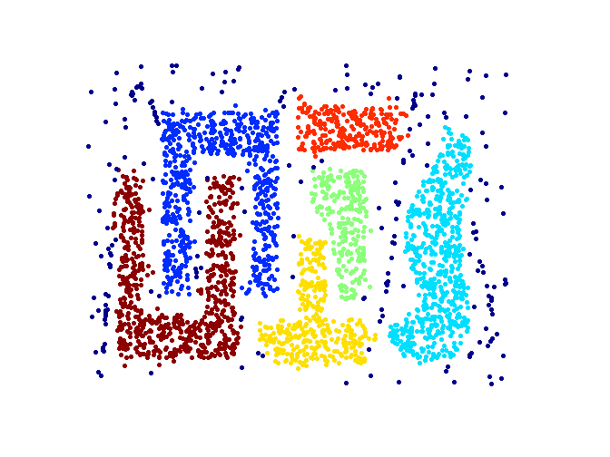
When DBSCAN Works Well
Original Points
Clusters (dark blue points indicate noise)
Can handle clusters of different shapes and sizes
Resistant to noise

Slide 65
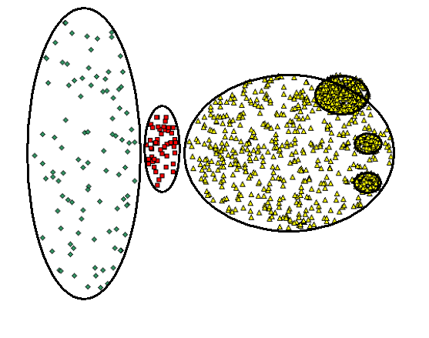
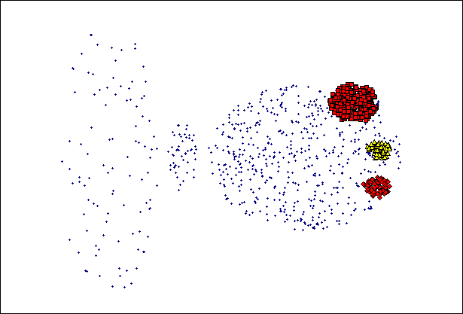
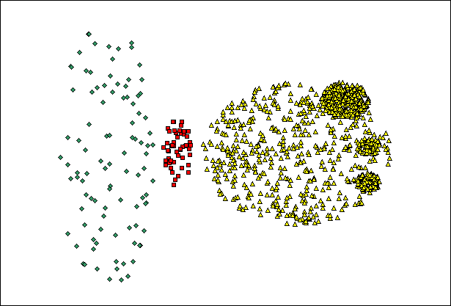
When DBSCAN Does NOT Work Well
(MinPts=4, Eps=9.92).
Original Points
Varying densities
High-dimensional data
(MinPts=4, Eps=9.75)

Slide 66
Cluster Evaluation (Cluster Validity)
For supervised classification we have a variety of measures to evaluate how good our model is
Accuracy, precision, recall
For cluster analysis, the analogous question is how to evaluate the “goodness” of the resulting clusters?
But “clusters are in the eye of the beholder”!
In practice the clusters we find are defined by the clustering algorithm
Then why do we want to evaluate them?
To avoid finding patterns in noise
To compare clustering algorithms
To compare two sets of clusters
To compare two clusters

Slide 67
Clusters found in Random Data
Random Points
DBSCAN
K-means
Complete Link

Slide 68
Measures of Cluster Validity
Numerical measures that are applied to judge various aspects of cluster validity, are classified into the following two types.
Supervised: Used to measure the extent to which cluster labels match externally supplied class labels.
Entropy
Often called external indices because they use information external to the data
Unsupervised: Used to measure the goodness of a clustering structure without respect to external information.
Sum of Squared Error (SSE)
Often called internal indices because they only use information in the data
You can use supervised or unsupervised measures to compare clusters or clusterings

Slide 69
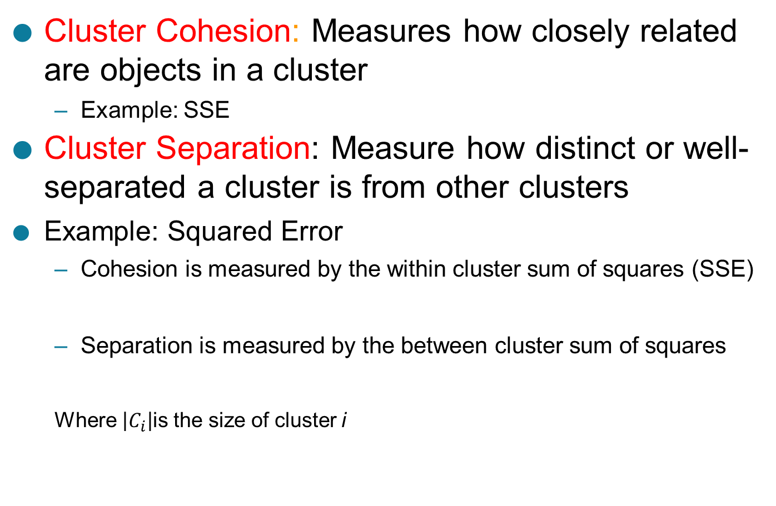
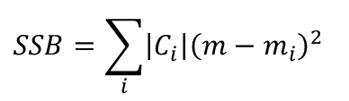
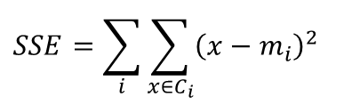
Unsupervised Measures: Cohesion and Separation
Cluster Cohesion: Measures how closely related are objects in a cluster
Example: SSE
Cluster Separation: Measure how distinct or well-separated a cluster is from other clusters
Example: Squared Error
Cohesion is measured by the within cluster sum of squares (SSE)
Separation is measured by the between cluster sum of squares
Where $\left|C_{i}\right|$is the size of cluster i
$$SSE=\sum_{i}{\sum_{x∈C_{i}}{{\left(x−m_{i}\right)}^{2}}}$$
$$SSB=\sum_{i}{\left|C_{i}\right|{\left(m−m_{i}\right)}^{2}}$$

Slide 70



Unsupervised Measures: Cohesion and Separation
Example: SSE
SSB + SSE = constant
m
×
×
×
1
m₁
2
3
4
m₂
5
K=1 cluster:
$$SSE={\left(1−3\right)}^{2}+{\left(2−3\right)}^{2}+{\left(4−3\right)}^{2}+{\left(5−3\right)}^{2}=10$$
$$SSB=4×{\left(3−3\right)}^{2}=0$$
$$Total=10+0=10$$
K=2 clusters:
$$SSE={\left(1−1.5\right)}^{2}+{\left(2−1.5\right)}^{2}+{\left(4−4.5\right)}^{2}+{\left(5−4.5\right)}^{2}=1$$
$$SSB=2 ×{\left(3−1.5\right)}^{2}+2×{\left(4.5−3\right)}^{2}=9$$
$$Total=1+9=10$$

Slide 71
Unsupervised Measures: Cohesion and Separation
A proximity graph-based approach can also be used for cohesion and separation.
Cluster cohesion is the sum of the weight of all links within a cluster.
Cluster separation is the sum of the weights between nodes in the cluster and nodes outside the cluster.
cohesion
separation

Slide 72
Unsupervised Measures: Silhouette Coefficient
Silhouette coefficient combines ideas of both cohesion and separation, but for individual points, as well as clusters and clusterings
For an individual point, i
Calculate a = average distance of i to the points in its cluster
Calculate b = min (average distance of i to points in another cluster)
The silhouette coefficient for a point is then given by s = (b – a) / max(a,b)
Value can vary between -1 and 1
Typically ranges between 0 and 1.
The closer to 1 the better.
Can calculate the average silhouette coefficient for a cluster or a clustering

